Slide 1
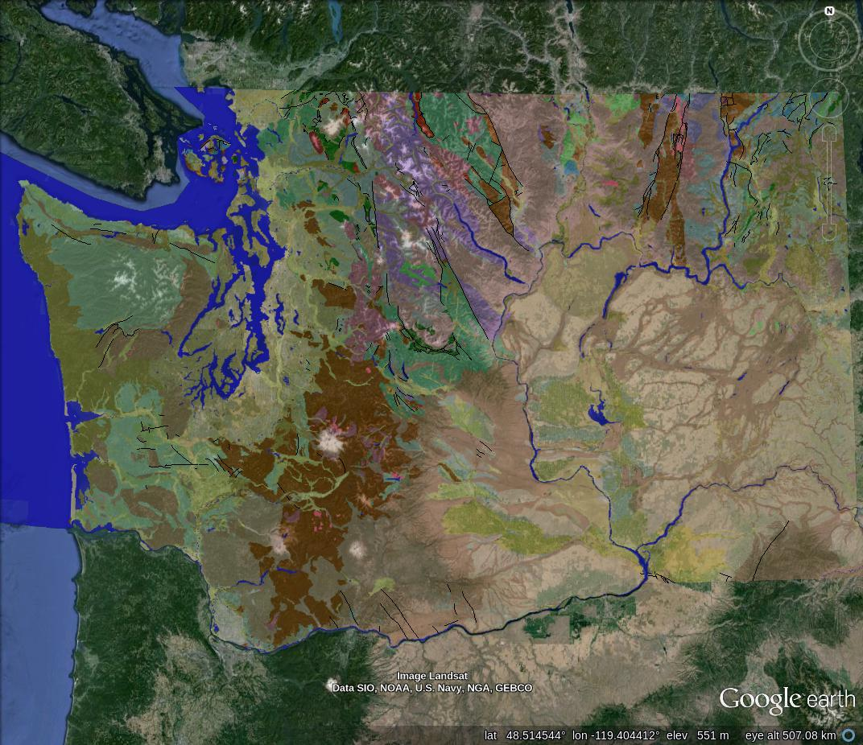
Magnetic and Gravity Mapping of the Seattle Area
Steven Rizo

Slide 2
Magnetic Data
The full magnetic dataset gridded by Blakely and colleagues was obtained and can be found at: http://pubs.usgs.gov/of/1999/of99-514/
The data was converted into a WGS84 latitude longitude netCDF grid file and plotted using gmt

Slide 3
Magnetic Map
A curved ridge of magnetic anomaly in the Southwest corner
E-W trending ridge of magnetic anomaly in the North
Complex anomalies in the south that are probably near the surface

Slide 4
Gravity Data
Gravity data was obtained from 47-49 degrees North to 121.5-123.5 degrees West using: http://irpsrvgis08.utep.edu/viewers/Flex/GravityMagnetic/GravityMagnetic_CyberShare/
The useful data columns were extracted and plotted using gmt

Slide 5
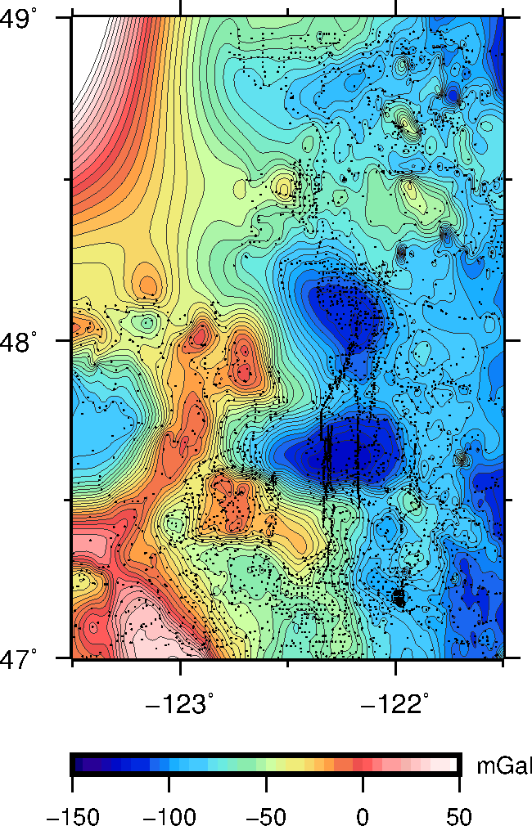
Gravity Map
The large data point gap in the Northwest is due to the lack of data across the US-Canada border.
Two large gravity lows of around -125 mGal are in the center of the map
A curved ridge and large area of gravity highs in the Southwest corner ranging from around 0 to 50 mGal
A smaller line of gravity high around -35 mGal in the North trending E-W

Slide 6
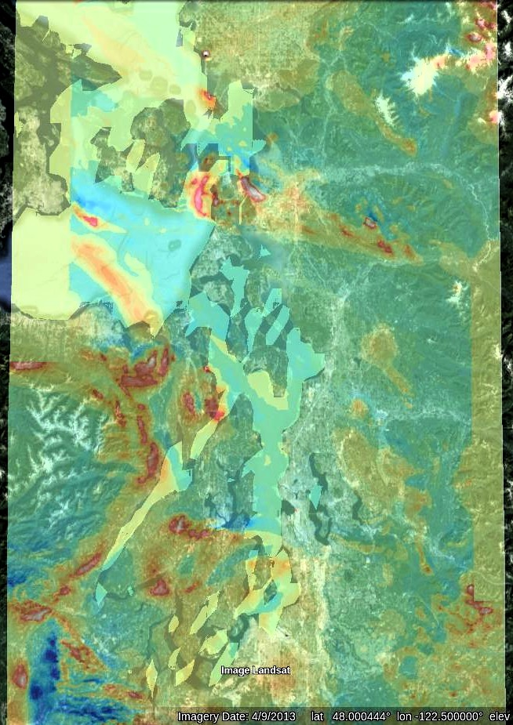
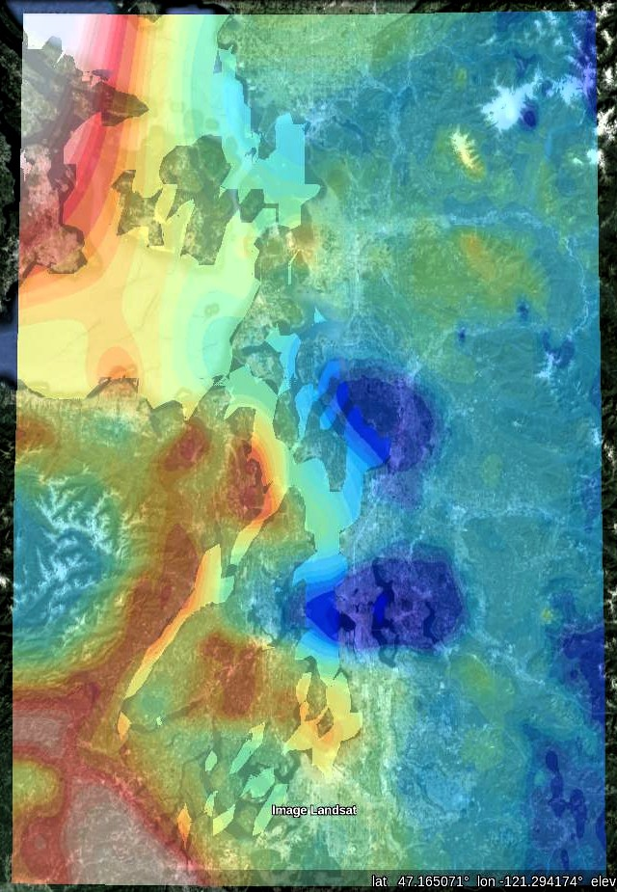
Comparing Magnetic and Gravity Maps

Slide 7
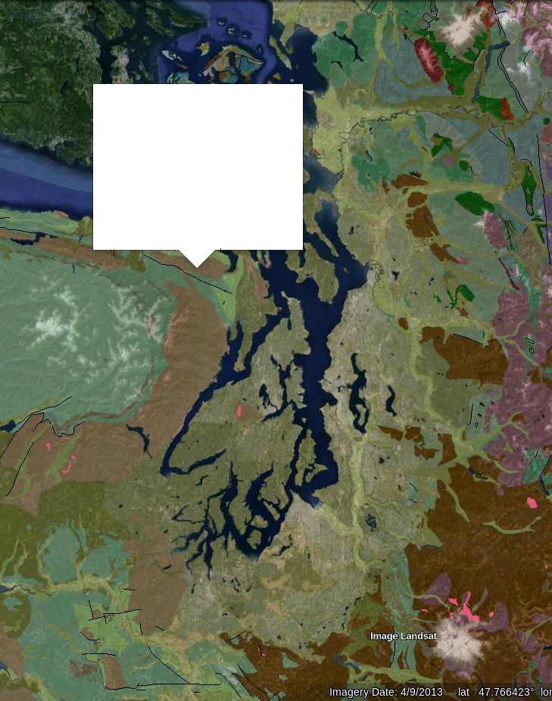

Slide 8
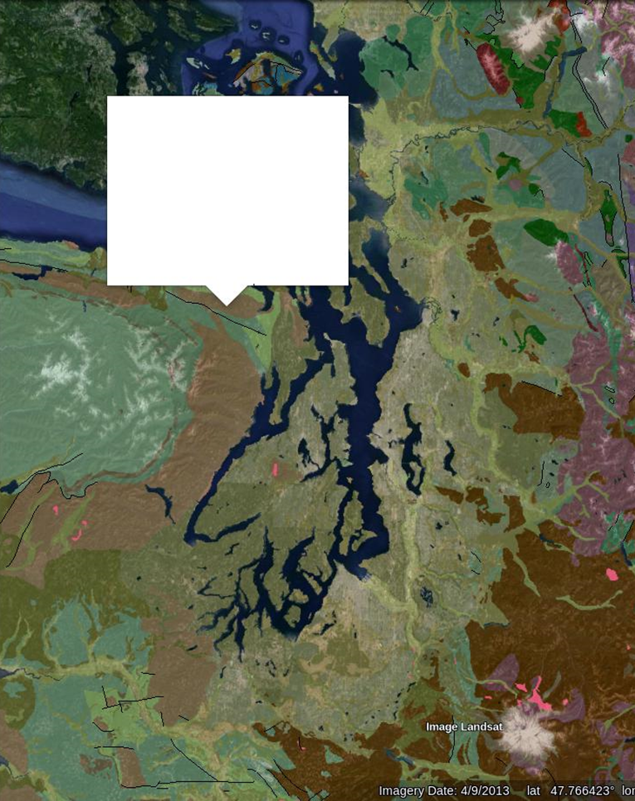

Slide 9

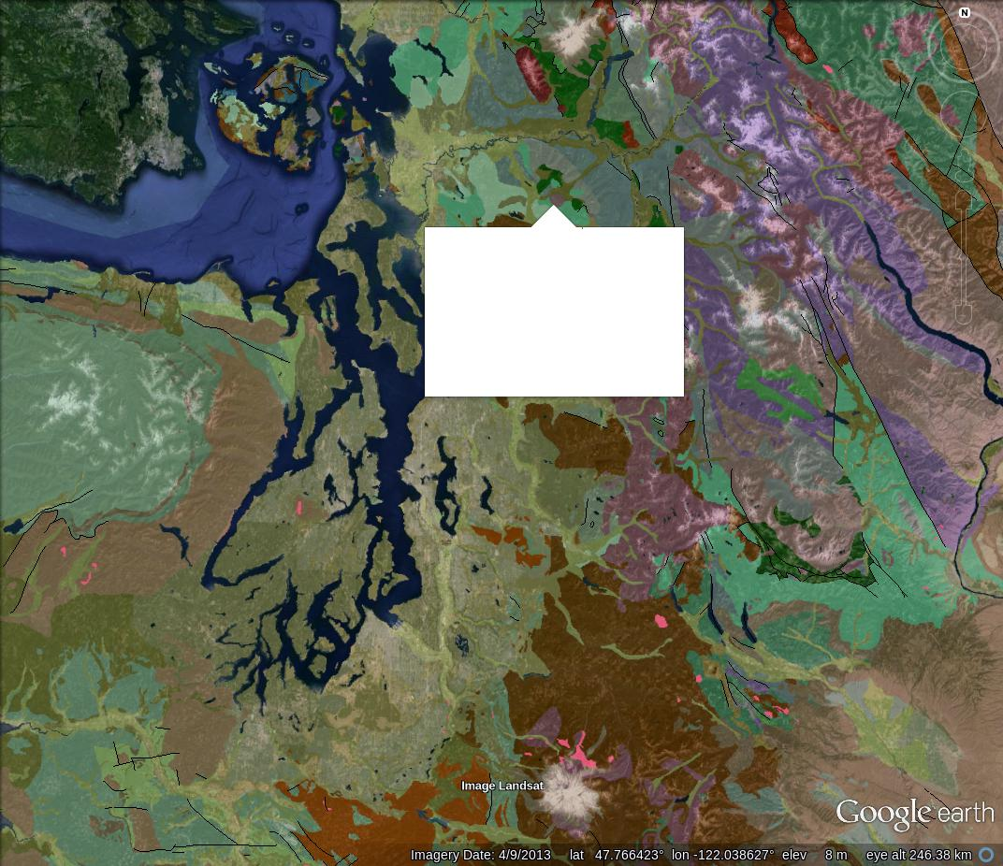

Slide 10


